Slide 1
Review of Analysis Steps for Structural MRI
Irene Vavasour
UBC MRI Research Centre Monthly Analysis Meeting
Nov 5, 2025

Slide 2
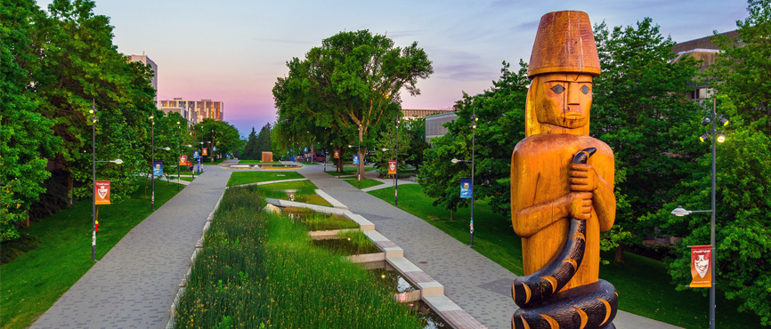
Land Acknowledgement
With gratitude, I acknowledge that I work, live and thrive on the traditional, ancestral, unceded territory of the Coast Salish nations including the xʷməθkʷəy̓əm (Musqueam), Skwxwú7mesh (Squamish) and səl̓ilwətaɁɬ (Tsleil-Waututh) peoples.

Slide 3
Structural MRI
3DT1
segment tissues or regions of interest
registration
PDw/T2w/FLAIR
identify tissue abnormalities
Diffusion tensor imaging (DTI)
measures movement of water
sensitive to tissue microstructure include axons and myelin
Myelin water imaging (MWI)
measures myelin

Slide 4
Some pre-processing for 3DT1 images?
Main software used
FSL: FMRIB Software Library
known for a number of image processing tools
ANTs: Advanced Normalization Tools
known for registration
FreeSurfer
known for volume parcellation

Slide 5
FSL
Great documentation on their wiki
https://fsl.fmrib.ox.ac.uk/fsl/docs/

Slide 6
fsl_anat
Performs most pre-processing steps for 3DT1
The stages in this pipeline (in order) are:
reorient the images to the standard (MNI) orientation [fslreorient2std]
automatically crop the image [robustfov]
bias-field correction (RF/B1-inhomogeneity-correction) [FAST]
registration to standard space (linear and non-linear) [FLIRT and FNIRT]
brain-extraction [FNIRT-based or BET]
tissue-type segmentation [FAST]
subcortical structure segmentation [FIRST]

Slide 7
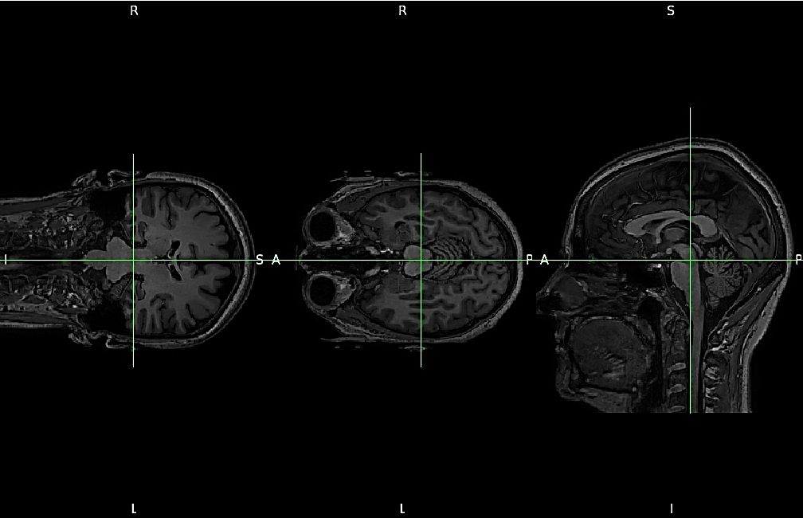
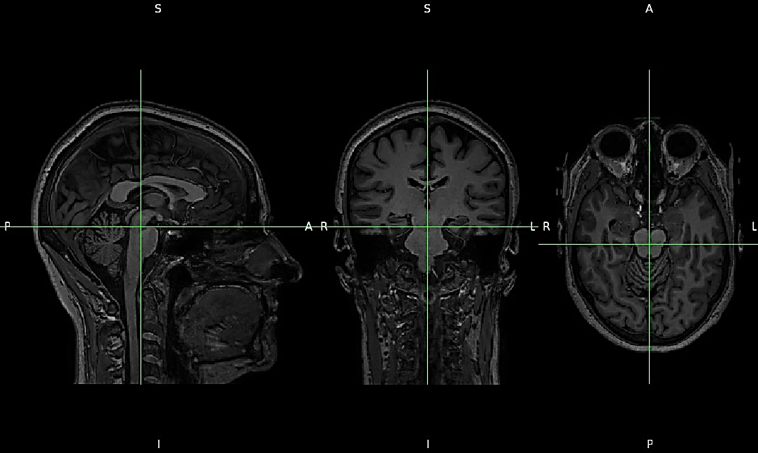
Reorient to standard orientation
usual orientation: axial with radiological convention
Sagittal Acquisition
MNI convention

Slide 8
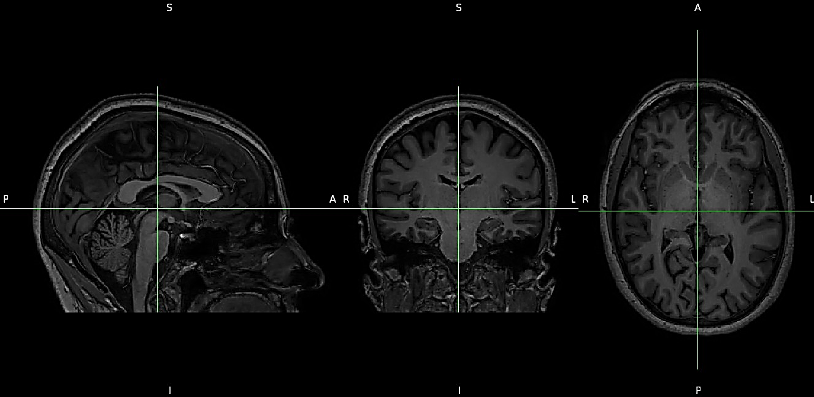
Crop off the neck
Remove lower part of image (neck) to focus on brain

Slide 9
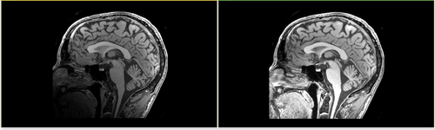
Bias Field Correction
Removes shading within image

Slide 10
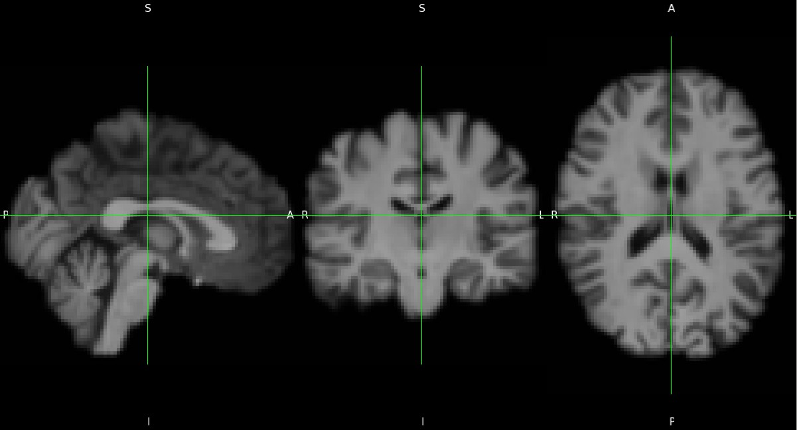
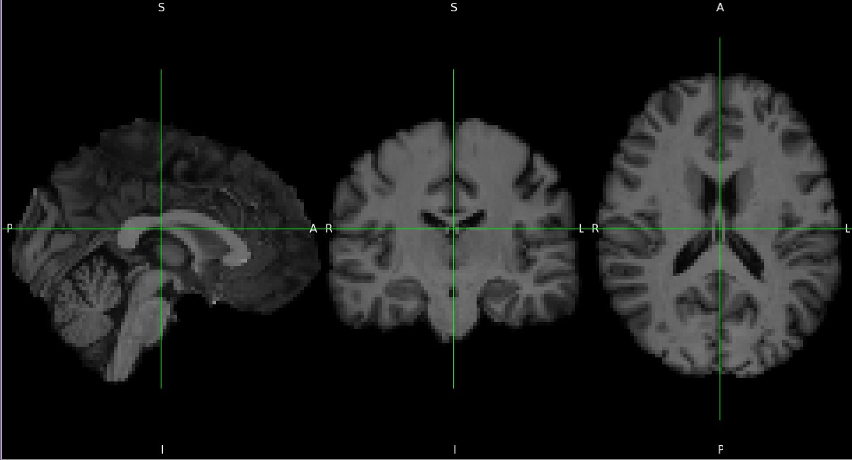
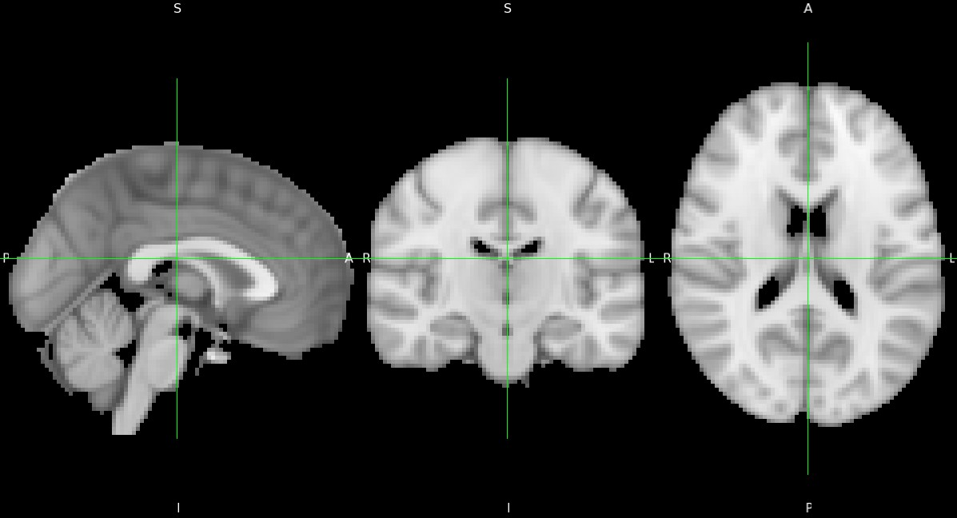
Registration to standard space (MNI)
FLIRT
Original
FNIRT
MNI

Slide 11
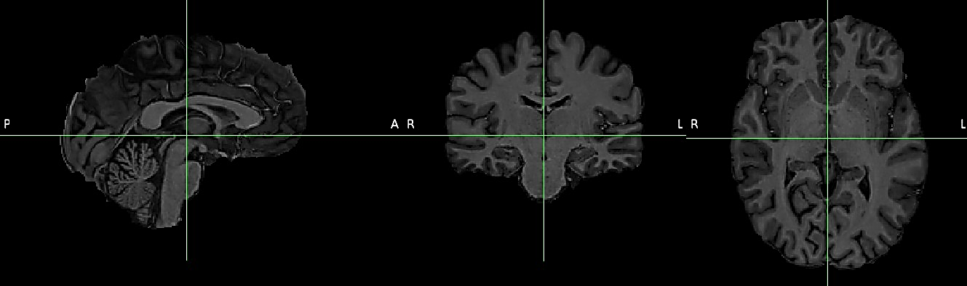
Brain Extraction

Slide 12
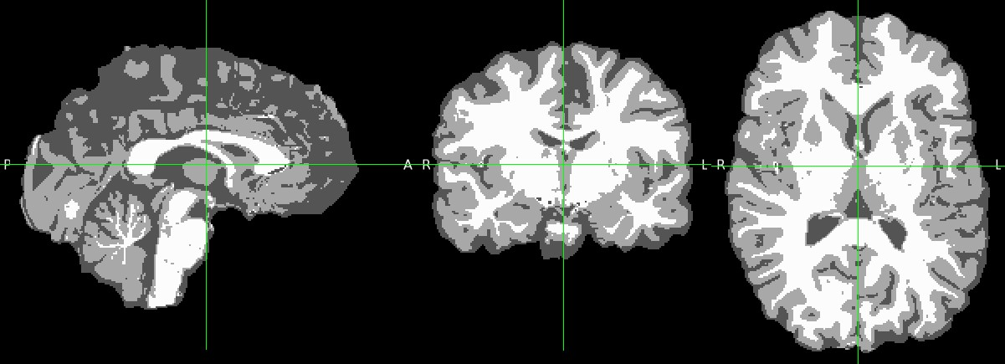
Tissue Segmentation
White Matter Grey Matter CSF

Slide 13
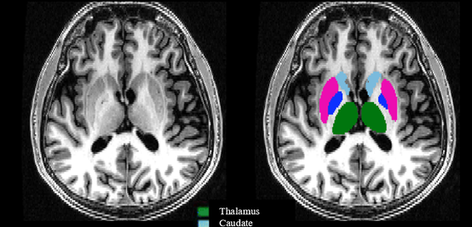
Subcortical segmentation
Thalamus
Caudate
Putamen
Globus Pallidus

Slide 14
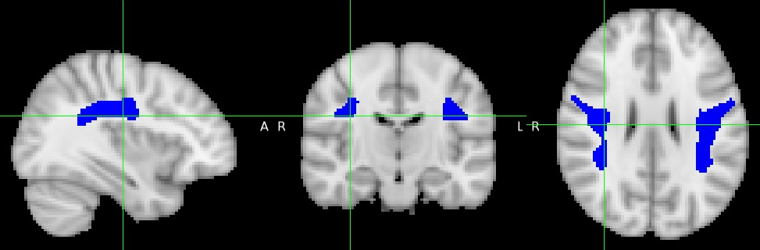
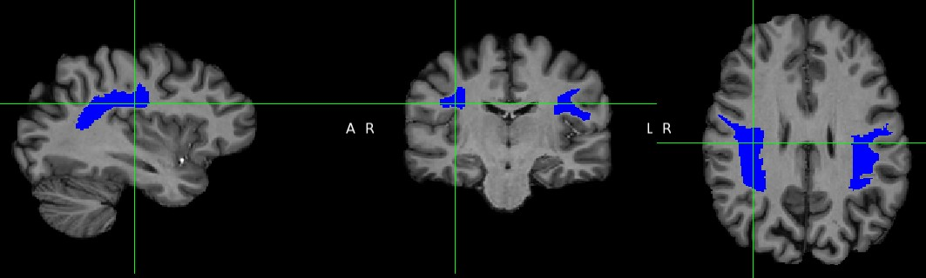
ROI Analysis
Take ROIs defined in an MNI atlas (like JHU or Harvard-Oxford) and move them back into original image space
use the inverse warp from the FNIRT step
Inverse Warp
Superior Longitudinal Fasciculus in MNI space
Superior Longitudinal Fasciculus in original space

Slide 15
Other FSL tools
fsleyes
used to view images
Lesion filling
if given a lesion mask, can fill in the lesions with surrounding “normal” tissue values.
can improve segmentation and registration
SIENA and SIENAX
can estimate brain volume or change in brain volume
FSL-VBM
VBM=voxel-based morphometry
allows voxelwise comparisons of parameters or changes from normal

Slide 16
ANTs
Most known for registration
https://stnava.github.io/ANTs/
Documentation isn’t as good as FSL
might be best to use someone else’s code and modify for your project

Slide 17
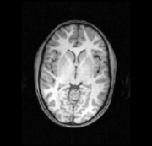
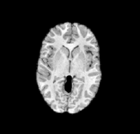
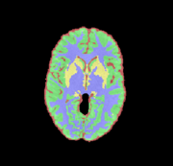
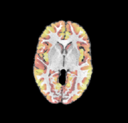
Segmentation
uses probability masks to help guide the segmentation and brain extraction
can also derive cortical thickness [antsCorticalThickness.sh]
3DT1
Brain Extracted
4-class segmentation
cortical thickness

Slide 18
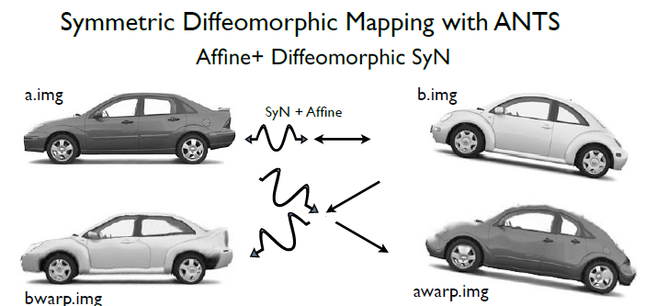
Registration
uses symmetric diffeomorphic transformation for best registration

Slide 19
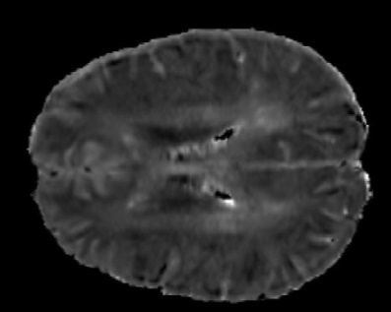
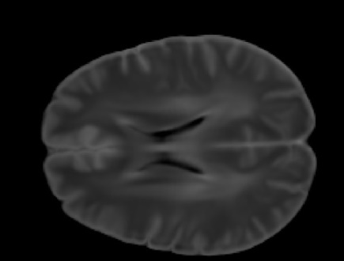
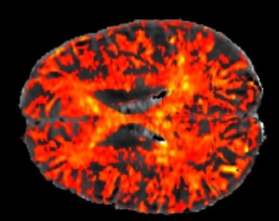
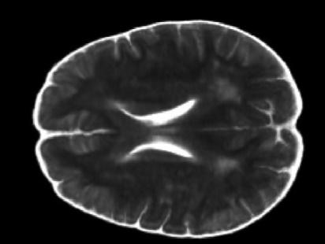
Atlas Creation
Can make an atlas from several images
will create a template of the all the images registered together
can then use to create z-score maps of individual participants compared to a healthy population
can also use to register several timepoints together
e.g. Z-score Calculation
-
MS IET₂
HC Mean IET₂
Z-scores
=
HC Standard
Deviation
0 5
Note: MS is an individual participant whereas HC comes from all healthy controls
From Atlas

Slide 20
FreeSurfer
Provides structural and functional analysis tools
https://surfer.nmr.mgh.harvard.edu/fswiki
Main Analysis Pipelines:
The Surface-based Stream
The Volume-based (Subcortical) Stream
Surface-based Statistical Analysis
Longitudinal Processing Stream

Slide 21
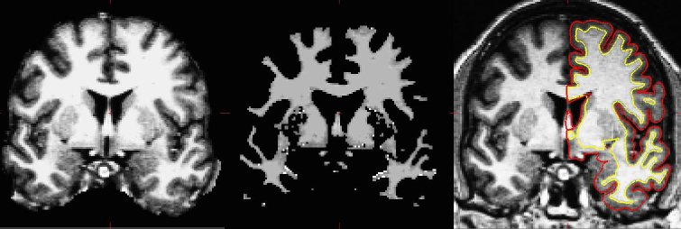
Surface Based Stream
Brain Extracted Image
White Matter Mask
surface between white and gray (yellow line) and between gray and pia (red line)

Slide 22
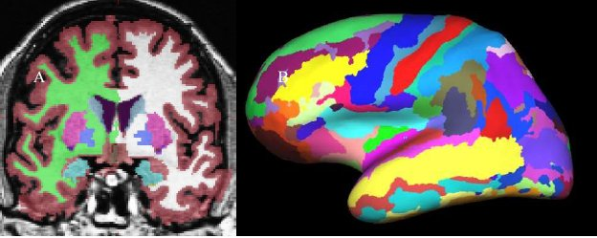
Volume Based Stream
Volume based labelling
Surface based labelling

Slide 23
Volumetrics
using the command recon-all can extract volumetrics
whole brain volume
with or without CSF
normalised to intra-cranial volume
WM/GM volumes
individual structures (e.g. thalamus, cerebellum)

Slide 24
White Matter Hyperintensities or Lesions
gold standard is manual identification of lesions and then growing based on their intensity
automatic segmentation available but not as robust
more recent versions use some sort of deep learning
MIMoSA
Lesion Segmentation Tool (LST-AI)
We’ve currently decided this is the best for our MS lesion segmentation

Slide 25
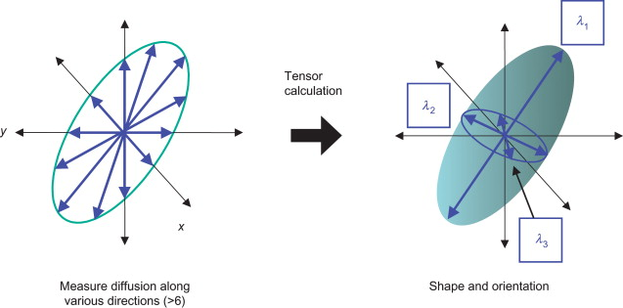
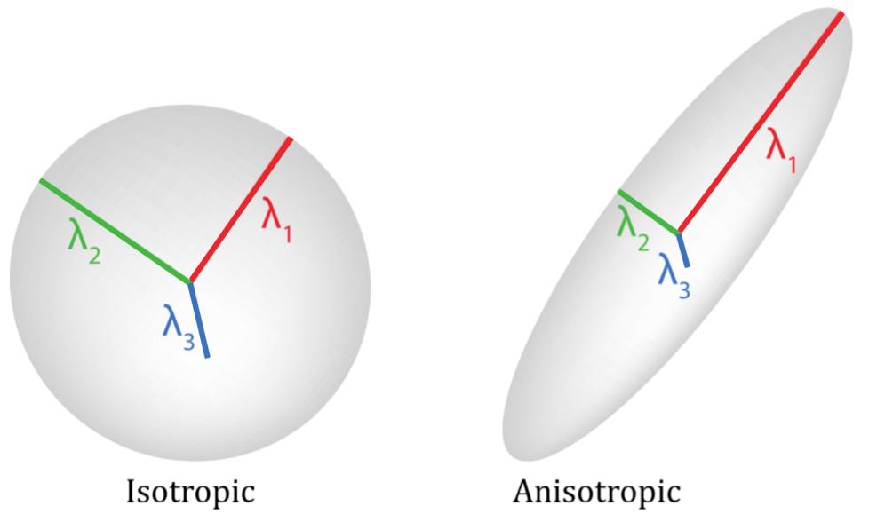
Diffusion Tensor Imaging
Measures movement of water within tissue

Slide 26
DTI analysis
Using FSL’s dti pipeline
1. separate B0 image
2. if opposite phase B0 image available then do topup
3. brain extract the B0 image
4. eddy current correct
5. calculate DTI parameters
- FA, MD, AD, RD

Slide 27
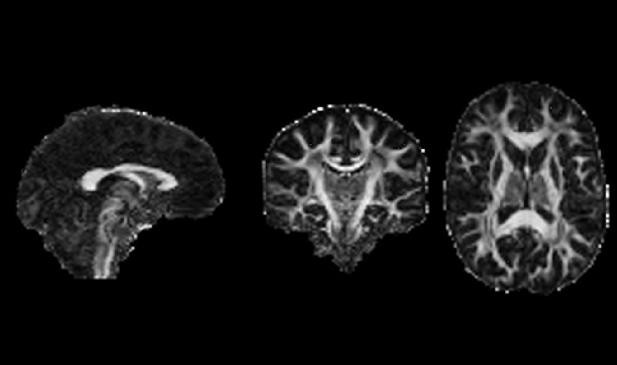
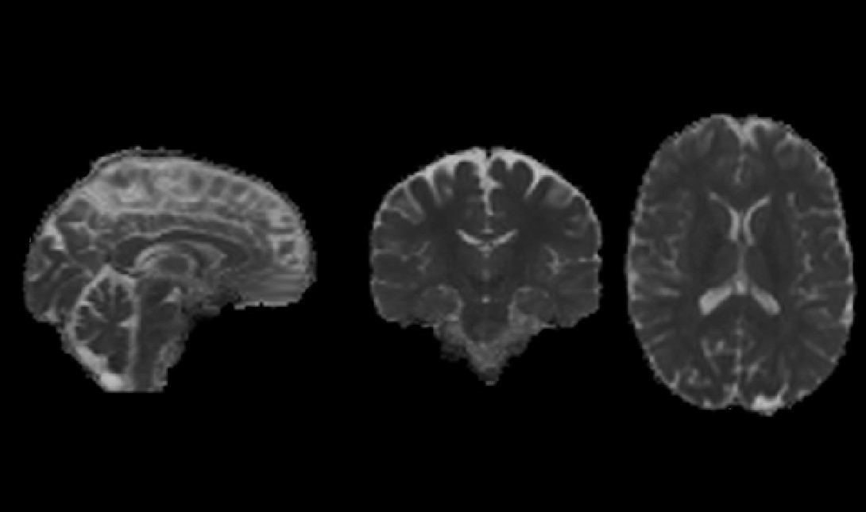
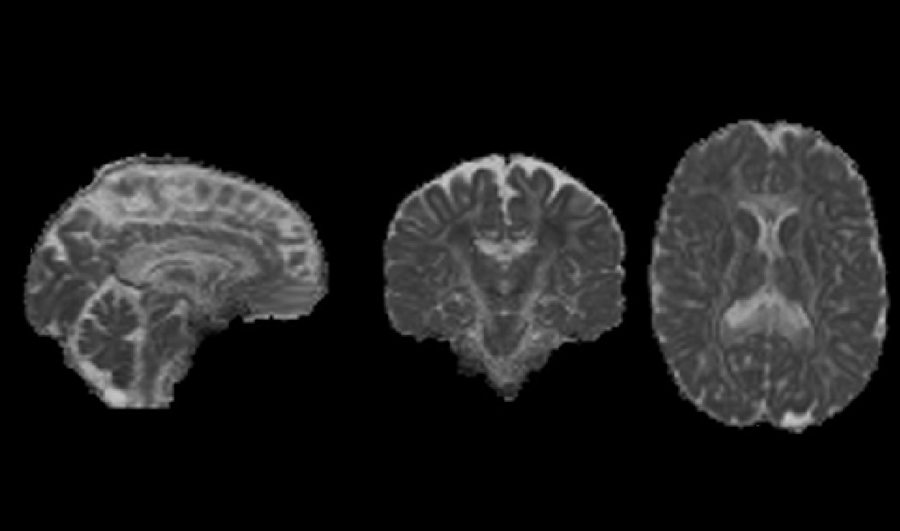
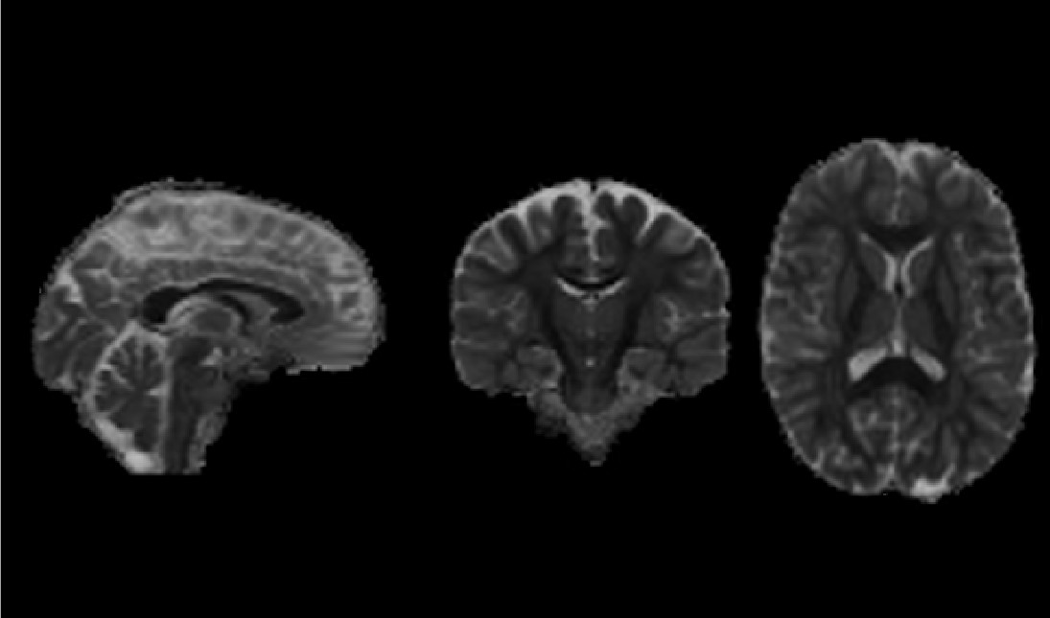
DTI analysis
Fractional Anisotropy
Mean Diffusivity
Axial Diffusivity
Radial Diffusivity

Slide 28
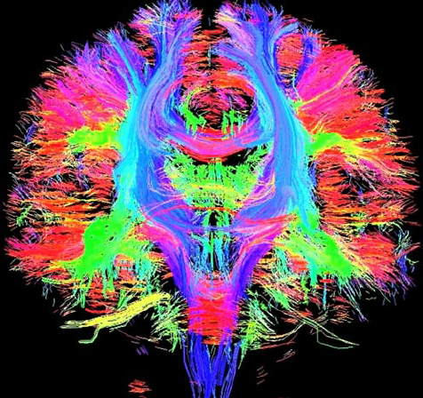
More complicated modeling for DTI
Requiring multi-shell (multiple b-values)
NODDI: Neurite Orientation Dispersion and Density Imaging
DBSI: Diffusion basis spectrum imaging
DKI: Diffusion Kurtosis Imaging
Tractography
follows direction of principle diffusion to define axon

Slide 29
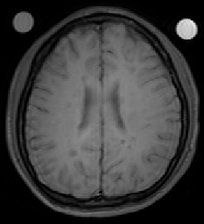
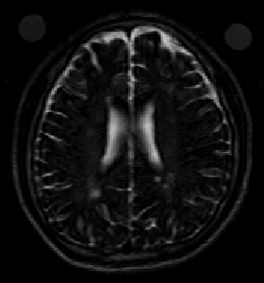
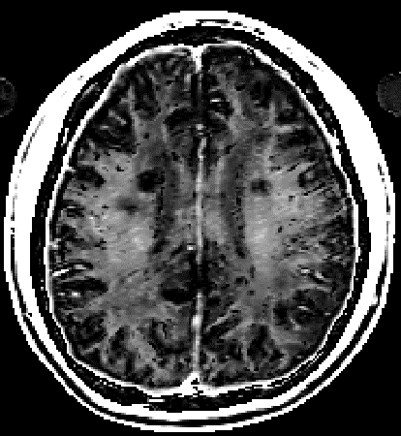
Myelin Water Imaging
Separates different water pools based on T₂ relaxation time
myelin water (T₂ < 40ms)
intra/extracellular water (40ms < T₂ < 200ms)
CSF (T₂ >1s)
Collect multiple echoes and fit to a multi-exponential decay
software used is DECAES (https://jondeuce.github.io/DECAES.jl)
DECAES
MET2 images
…
echo 1 echo 48
MWF

Slide 30
What to do with quantitative images?
You have your quantitative images, now what?
register you quantitative image to your 3DT1 or vice versa
apply masks or ROIs to get mean values or make histograms
extract your quantitative metric along a tract
make atlases and calculate z-scores for individual participants
do voxel based morphometry and compare images at a voxel level
do tract based spatial statistics (TBSS)
define a tract skeleton (middle of tract) then compare skeleton values between participants

Slide 31
Questions? Discussion?

Slide 32
Next meeting
Wednesday Dec 3rd
3:15-4:15
Topic: DTI of neurofluids?

